Slide 1
Time Series Analysis
Basics of Time Series Analysis: Data Example
Nicoleta Serban, Ph.D.
Associate Professor
Stewart School of Industrial and Systems Engineering
Trend and Seasonality Estimation

Slide 2
About this lesson

Slide 3
Trend Estimation
## Equally spaced time points
time.pts = c(1:length(Volume))
time.pts = c(time.pts - min(time.pts))/max(time.pts)
## Local Polynomial Trend Estimation
loc.fit = loess(Volume.tr~time.pts)
vol.fit.loc = fitted(loc.fit)
## Splines Trend Estimation
library(mgcv)
gam.fit = gam(Volume.tr~s(time.pts))
vol.fit.gam = fitted(gam.fit)
## Is there a trend?
plot(dates,Volume.tr,ylab="ED Volume")
lines(dates,vol.fit.loc,lwd=2,col="brown")
lines(dates,vol.fit.gam,lwd=2,col="red")

Slide 4
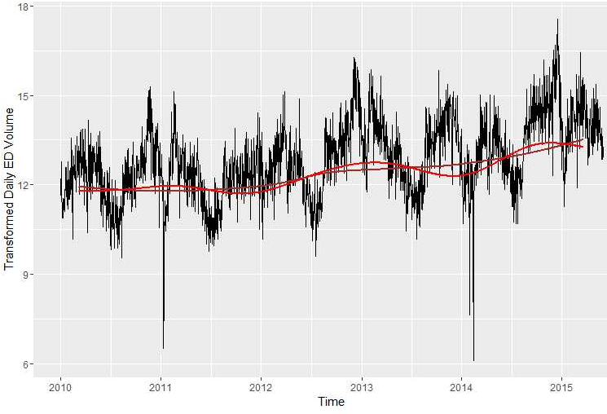
Trend Estimation

Slide 5
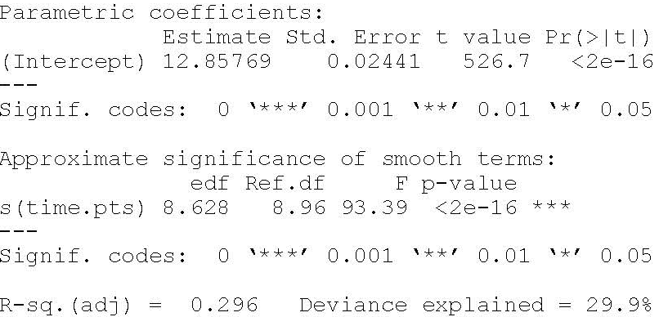
Trend Estimation (cont’d)
Smooth trend is statistically significant
29.6% of variability explained

Slide 6
Trend and Seasonality Estimation
## Model Trend + Monthly Seasonality
month = as.factor(format(dates,"%b"))
gam.fit.seastr.1 = gam(Volume.tr~s(time.pts)+month-1)
summary(gam.fit.seastr)
vol.fit.gam.seastr.1 = fitted(gam.fit.seastr.1)
ggplot(edvoldata, aes(dates, sqrt(Volume+3/8))) + geom_line() + xlab("Time") + ylab("Transformed Daily ED Volume")
lines(dates,vol.fit.gam.seastr.1,lwd=2,col="red")

Slide 7
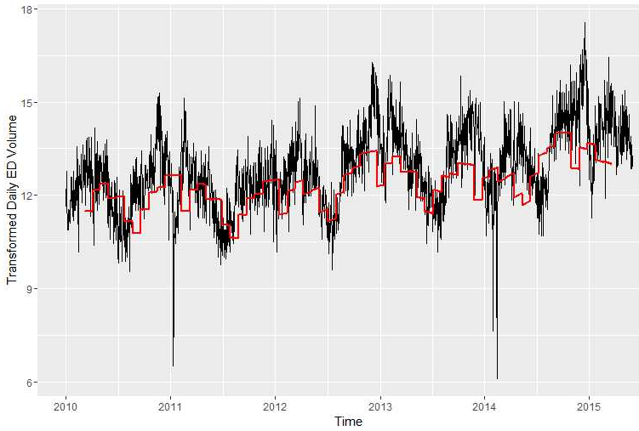
Trend and Seasonality Estimation

Slide 8
Trend and Seasonality Estimation (cont’d)
## Add day-of-the-week seasonality
week = as.factor(weekdays(dates))
gam.fit.seastr.2 = gam(Volume.tr~s(time.pts)+month+week)
summary(gam.fit.seastr.2)
vol.fit.gam.seastr.2 = fitted(gam.fit.seastr.2)
## Compare the two fits
ggplot(edvoldata, aes(dates, vol.fit.gam.seastr.2)) + geom_line() + xlab("Time") + ylab("Seasonality and Trend: Daily ED Volume")
lines(dates,vol.fit.gam.seastr.1,lwd=2,col="red")

Slide 9
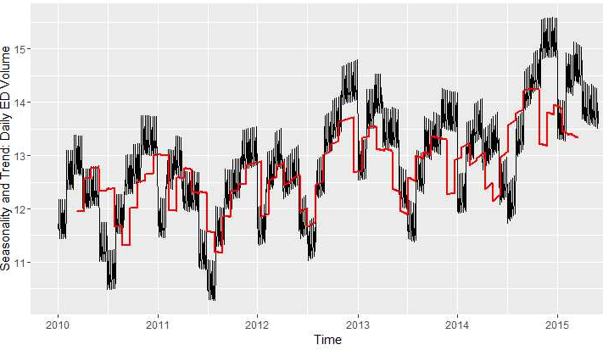
Trend and Seasonality Estimation (cont’d)

Slide 10
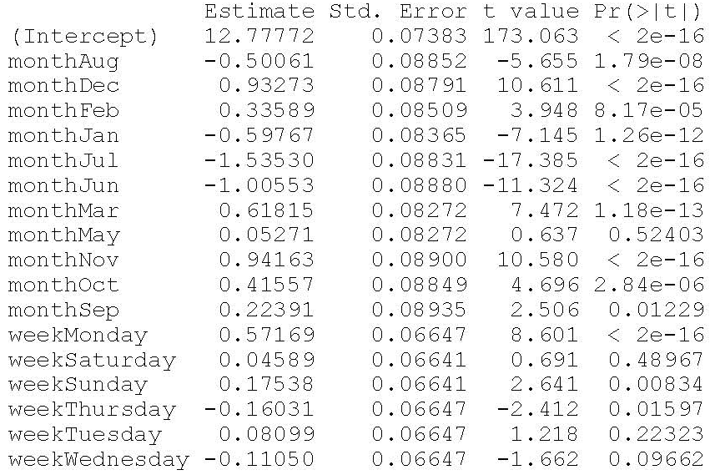
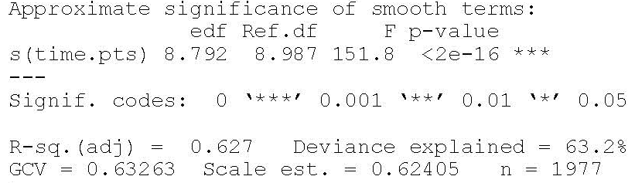
Trend and Seasonality Estimation (cont’d)
Most regression coefficients are statistically significant
Some regression coefficients are statistically significant
Smooth trend is statistically significant
62.7% of variability explained

Slide 11
Trend and Seasonality Estimation (cont’d)
## ## Does the addition of seasonality of day of the week adds predictive power?
lm.fit.seastr.1 = lm(Volume.tr~month)
lm.fit.seastr.2 = lm(Volume.tr~month+week)
anova(lm.fit.seastr.1,lm.fit.seastr.2)

Slide 12
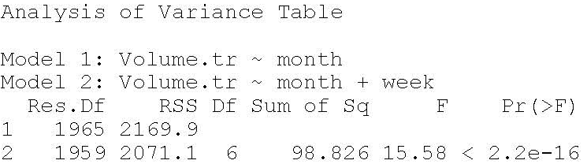
Trend and Seasonality Estimation (cont’d)
## ## Does the addition of seasonality of day of the week adds predictive power?
lm.fit.seastr.1 = lm(Volume.tr~month)
lm.fit.seastr.2 = lm(Volume.tr~month+week)
anova(lm.fit.seastr.1,lm.fit.seastr.2)
The seasonality due to day of the week improves the prediction power of the model

Slide 13
Seasonality vs Trend
## Compare with & without trend
ggplot(edvoldata, aes(dates, vol.fit.gam.seastr.2)) + geom_line() + xlab("Time") + ylab("Seasonality and Trend: Daily ED Volume")
lines(dates,vol.fit.lm.seastr.2,lwd=2,col="blue")
lines(dates,vol.fit.gam,lwd=2,col="red")

Slide 14
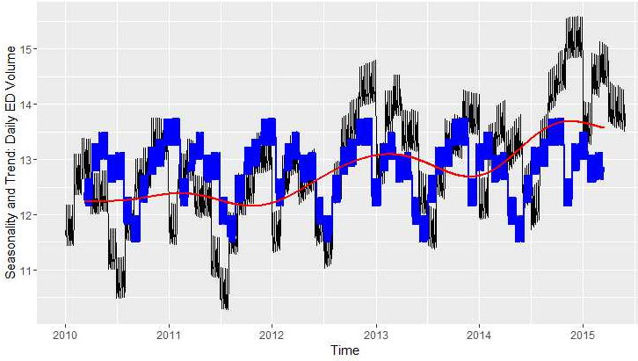
Seasonality vs Trend

Slide 15
Summary

